Slide 1


ENGLISH LEVEL B1 - II
Lesson 05
COMMUNICATING BY EMAIL

Slide 2

01
How to communicate by Email
ENGLISH LEVEL B1 - II

Slide 3

COMMUNICATING BY EMAIL
SITUATIONS BY EMAIL
Vocabulary:
Read these situations and answer the questions.
You need to email your professor about a missed assignment deadline.
You want to ask a company for information about a job opening.
You are responding to a customer inquiry in a professional setting.
Discussion questions:
What is the purpose of each email?
What tone would be appropriate for each situation?
What phrases might be useful for each case?

Slide 4
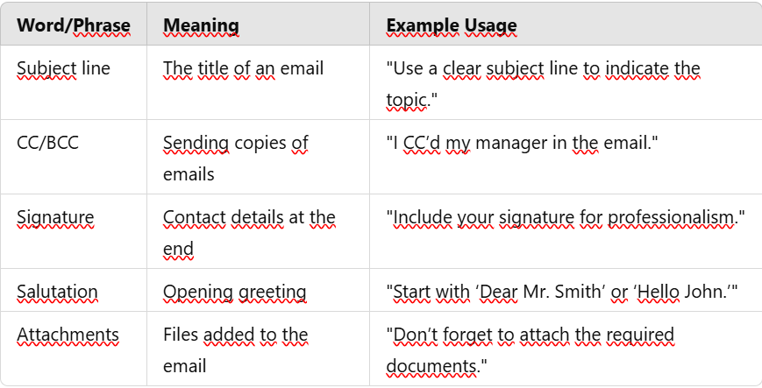
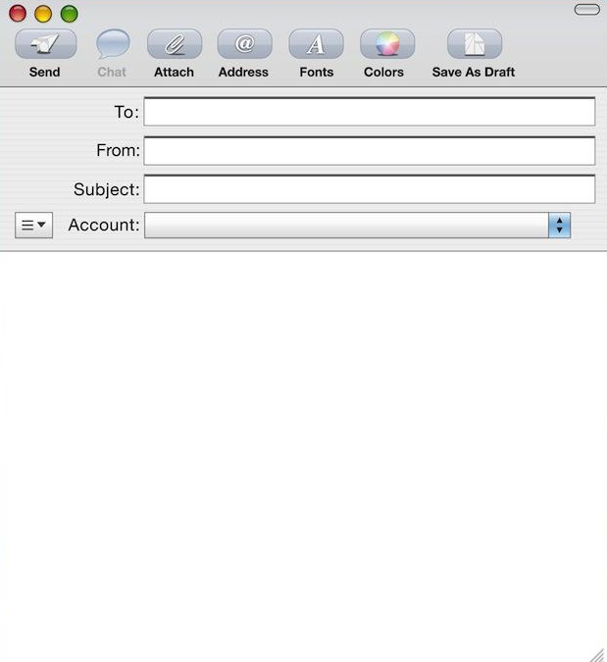
COMMUNICATING BY EMAIL
Vocabulary:
Activity:
Complete the text with the correct words.
"Before sending an email, ensure that your (1)______ is clear and concise.
If you need to send documents, make sure you include them as (2)______.
Use an appropriate (3)______ such as 'Dear' or 'Hello,' depending on the level of formality.
Always end the email with a professional (4)______ that includes your contact details.“
Alternatives: signature, subject line, salutation attachments

Slide 5

COMMUNICATING BY EMAIL
WRITING AN EMAIL IN GROUPS:
Work in to draft an email based on a given scenario.
Scenario: You are requesting information about a training course offered by a company. Your email should include:
A clear subject line.
A polite greeting and introduction.
The purpose of your email.
A closing statement and signature.
Each group presents their email to the class for discussion.

Slide 6


COMMUNICATING BY EMAIL
CLASS DISCUSSION: REFLECT AND APPLY
What are three key elements of a professional email?
How does the tone of an email affect communication?
What should you do before sending an email to ensure clarity and correctness?

